Slide 1
FSR v2
Improved how FSRs are understood, tagged, chunked, and retrieved

Slide 2
Problem
FSR documents are not structurally uniform:
A single document may contain multiple equipment types, multiple ESNs, shared sections, and nested subsections.
Important evidence is not always expressed consistently: the same equipment may appear in a heading, a table, a subsection title, or surrounding context.
Multi-equipment FSRs (Gas Turbine + Generator on same document) have two failure modes:
Retrieval miss — User queries Generator ESN, but chunks are tagged with GT ESN.
Wrong label — Generator content (stator, rotor, field) is labeled "Gas Turbine" because the FSR listed the GT ESN first → LLM risk assessment confuses equipment type → wrong remediation recommendation.

Slide 3
Metadata Processor Improvements
Regex-based detection with fast deterministic processing - identifies ESNs, section headers, and equipment regions, with form numbers and keyword density as fallbacks.
Outputs equipment metadata and region tags so each chunk inherits the correct equipment label.
Fixed subsection context switching, including deeply nested sections, to correctly restore the parent equipment context.
Improved section-header detection at page boundaries across varying page-offset formats.
Added guardrails for unnumbered headers, Generator keywords, IBAT ESN validation/fallback, and TOC-based filtering to reduce false detections.
FSR v2 treats preprocessing as a structured interpretation problem, not just text splitting. It separates document understanding, metadata extraction, normalization, and chunking so that each stage can be validated and improved independently.

Slide 4
What improved: More Accurate, Reusable Evidence
More accurate evidence
The new preprocessor improved QA implementation accuracy from the previous baseline and reduced noisy and missing evidence across validated ESN documents.
It distinguishes Steam Turbine, Gas Turbine, Generator, and other equipment contexts more reliably.
Deterministic fixes address difficult hierarchy, section, ESN, and equipment-type cases, and are checked against known regression cases.
More useful metadata
Extracted metadata enables stronger filtering and labeling for retrieval and downstream analysis.
Equipment type, ESN context, section path, source, confidence, and processing status travel with the evidence.
Preprocessor regions preserve document structure, making chunks more interpretable and easier to validate.
Reusable extracted documents
FSR extraction results are persisted instead of discarded after one processing step.
The same extracted representation is reused by chunking, validation, and future consumers.
Reuse supports replay and troubleshooting and avoids reprocessing the original PDF for every downstream capability.
Measured experimentation and continuous validation
MLflow experiments help the data science team compare approaches on larger datasets and make informed decisions.
Validation artifacts turn difficult examples into regression cases, preventing old failures from returning quietly.
Shared and ambiguous sections remain explicit follow-up work rather than hidden assumptions.
FSR V2 has faster and more precise filtering, less repeated document processing, more efficient experimentation, and a clearer path from a difficult PDF to trustworthy evidence.

Slide 5
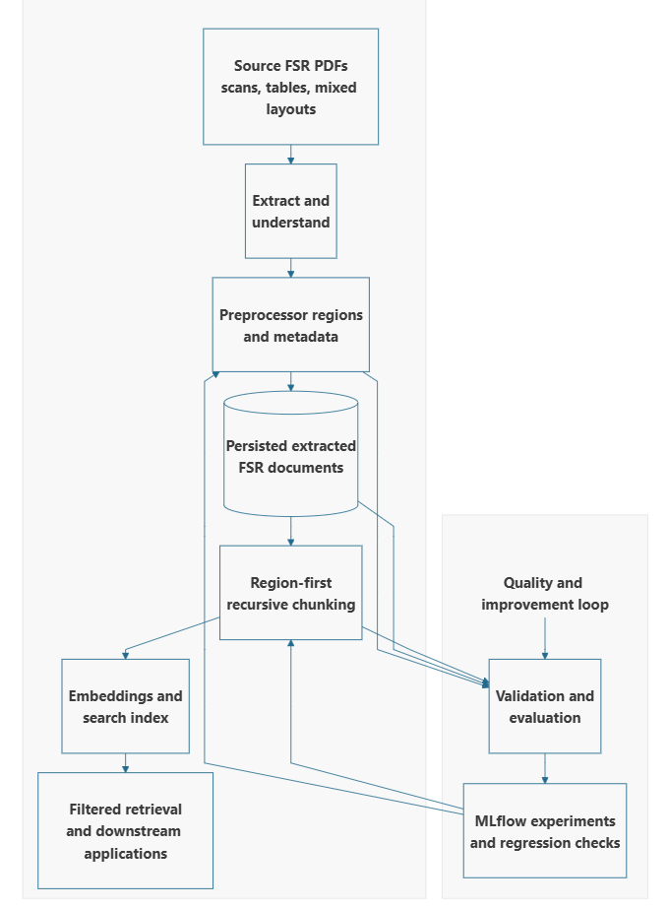
FSR v2 Architecture
How the pipeline works?
We identify the document regions and their context before splitting the text into chunks. This helps keep each chunk connected to the right equipment and section.
The extracted FSR is persisted and reused for chunking, validation, analysis, and future applications, so the original document does not need to be processed again for every use.
Equipment, ESN, section, and confidence metadata travel with each chunk. This gives downstream retrieval and analysis more useful information to work with.
We use difficult documents and known bug cases as regression tests and use evaluation datasets to track quality as the preprocessor changes.
Deterministic rules handle the cases we understand well. MLflow experiments help us measure and investigate the cases that remain ambiguous.

Slide 6
What's next: close the edge cases
Measure embedded sub-reports, appendix sections, mid-document tables of contents, unnumbered headings, and repeated Generator sections to identify where deterministic rules are sufficient and where LLM assistance is needed.
Complete the remaining deterministic preprocessor work: subsection flip-back, shared and ambiguous section handling, TOC verification, and IBAT validation of detected ESN equipment types.
Evaluate LLM parsing and Textract/Databricks AI Parser performance against the same difficult documents.
Validate that chunking preserves evidence, section paths, and ESN attribution, then check retrieval quality with targeted ESNs and larger retrieval K values.

